Slide 1
PlotMe
Interactive Data Visualizing Application

Slide 2
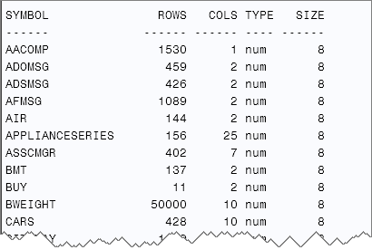
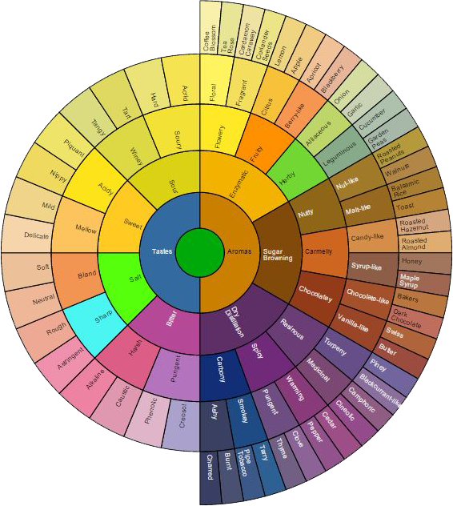
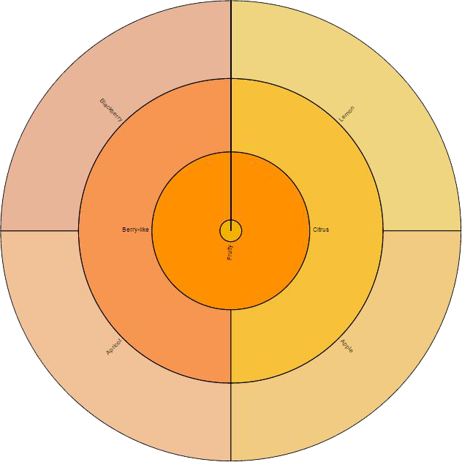
Main Goal
Make data easier to read
Interactive graphs

Slide 3
Scope
Domain: Businesses, Schools, Individuals, etc.
Easy accessibility (web-based application)
Fast and precise
Doable in two weeks

Slide 4

Motivation
Real world applications
Personal experience
Had to use excel to graph usage data for my application
Very tedious and inefficient

Slide 5
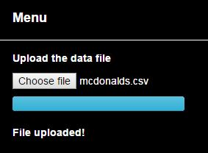
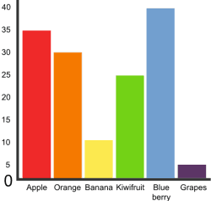
Functional Requirements
Follow the MVC design (Spring)
Input
User can upload file from their system
User can choose independent/dependent variables and graph type
Output
Appropriate graph (as chosen by user) with appropriate variables
User can interact with the graph (e.g. zoom in)
Ability to change the type of graph
Ability to change independent/dependent variables

Slide 6
Non-Functional Requirements
Browser compatibility with JS, CSS3, HTML5
Internet connection
Input
CSV file; at least two columns
Headings in first row (or column)
Contains “graphable” data (independent/dependent columns)
Output
Visually appealing graph with appropriate variables

Slide 7
Optimal Sorting Algorithm
Input: dataset(Olympic dataset), Category (trophies)
Output: Choose graph with a unique distribution
Steps
Graph will get the min, median, and all the quartile information
Sort it between all the graphs
Find the value’s IQR values added together
Choose the graph with the highest IQR

Slide 8
Optimal Sorting (Cont…)
Sorts an array using mergesort
But when the array gets divided into a size size it sorts using insertion sort
We found 15 to be the size to start using insertion sort

Slide 9
Binary Search Tree
Binary Search
Input:
Category(Countries: Canada), Dataset(Olympic dataset)
Output:
graph of data in that category
Example: histogram of trophies given in Canada
Implementation
Using a binary search tree that allows multiple keys.
We can also put the values such as min, max, and IQR in the BST to make previous process faster

Slide 10
Verification
The app creates an interactive graph to visualize given data sets successfully
Uses a BST to store and search relevant data, tests to ensure it's a BST by having a method that checks if height is Olog(n)
Uses merge sort for large data sets and insertion sort for smaller data sets
This can be tested by sorting sample data and ensuring the data is both correctly sorted and done so efficiently

Slide 11
Validation
The goal was to make it easier to analyze data for the user
To test if it met the client's needs and requirements were met we showed people our sample product
They were able to draw conclusions from it effectively
Prototype graph with sample data will be shown next

Slide 12
References
http://blogs.sas.com/content/iml/files/2013/07/read100datasets2.png
http://www.jasondavies.com/coffee-wheel/

